Slide 1
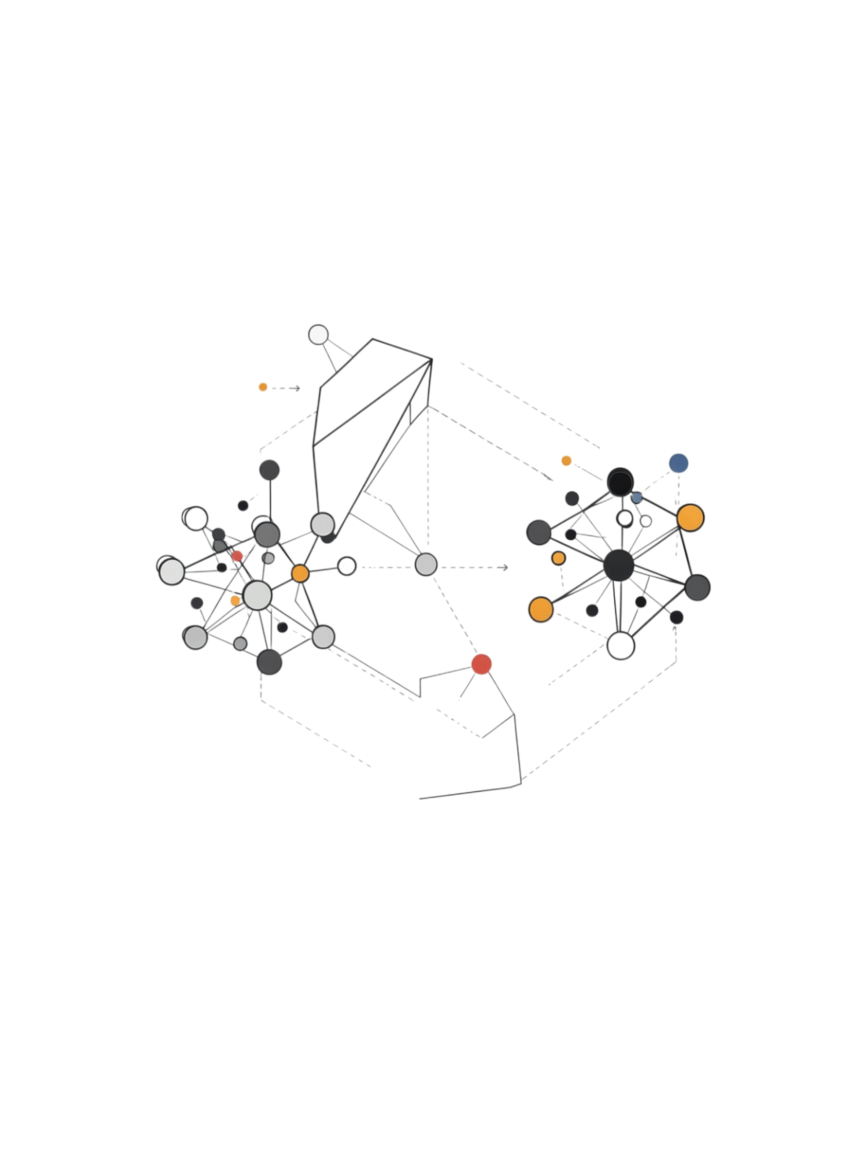
Support Vector Machine (SVM)
A powerful supervised learning algorithm used primarily for classification — and also for regression (SVR). The core idea: find the best boundary that separates different classes with the maximum possible margin.
Classification
Regression (SVR)
Separate classes with an optimal decision boundary
Predict continuous values within a margin of tolerance
Maximum Margin
SVM finds the boundary with the widest gap between classes

Slide 2
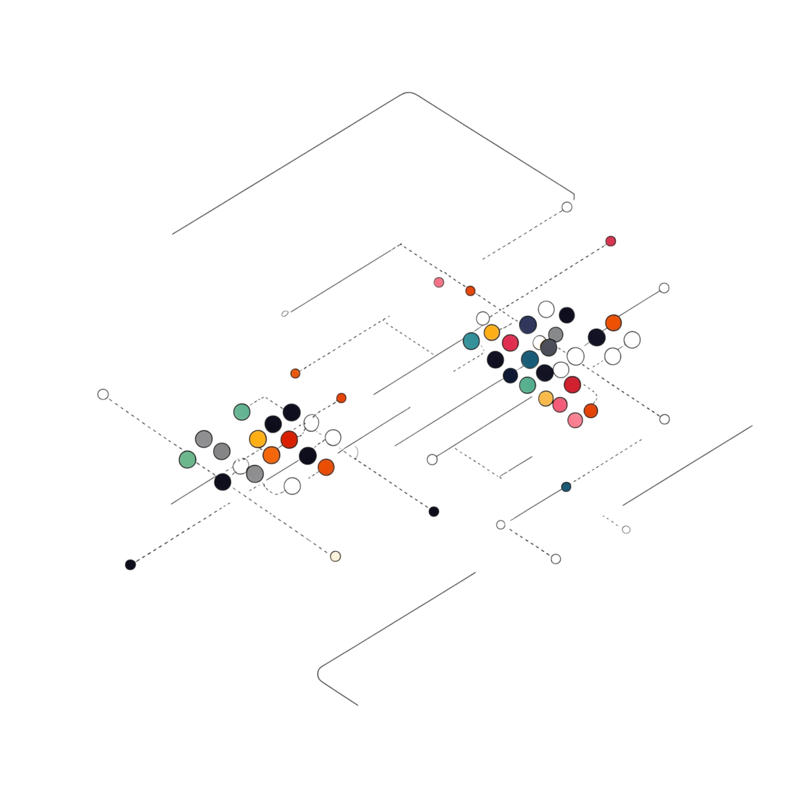

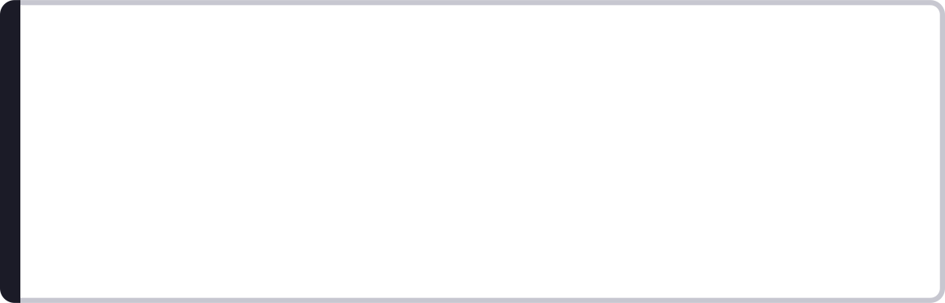
Understanding the Decision Boundary
Given a 2D dataset with Class 0 and Class 1, many lines can separate the classes — but which one is best?
SVM always prefers the boundary with the maximum margin — it generalizes better to unseen data.
Boundary A
Boundary B
Boundary C
Separates classes but has a small margin — risky for new data
Separates classes with a larger margin — more robust
Another valid separator, but not optimal

Slide 3
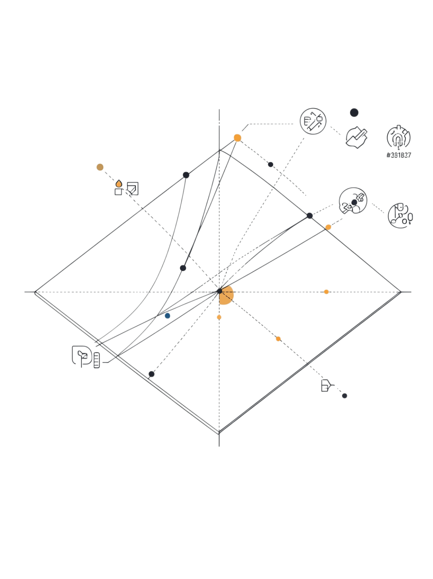
Support Vectors and Margin
Support Vectors
Decision Boundary
The data points closest to the decision boundary. These are the critical points that determine the position of the optimal boundary. Moving a support vector changes the boundary; moving any other point usually does not.
The central separating hyperplane
Upper Margin
Boundary touching Class 1 support vectors
Margin
The distance between the decision boundary and the nearest data points from each class. SVM maximizes this distance.
Lower Margin
Boundary touching Class 0 support vectors
Support Vectors
Highlighted critical data points on each margin line

Slide 4
Maximum Margin Intuition
A larger margin generally provides better separation and improves generalization to unseen data.
The Three Hyperplanes
Model A — Small Margin
Model B — Large Margin ✓
Boundary sits close to data points. Sensitive to noise and new observations.
Boundary is far from both classes. More robust and generalizes better.
w = weight vector (orientation of the boundary)
x = feature vector (input data point)
b = bias / intercept (shifts the boundary)

Slide 5
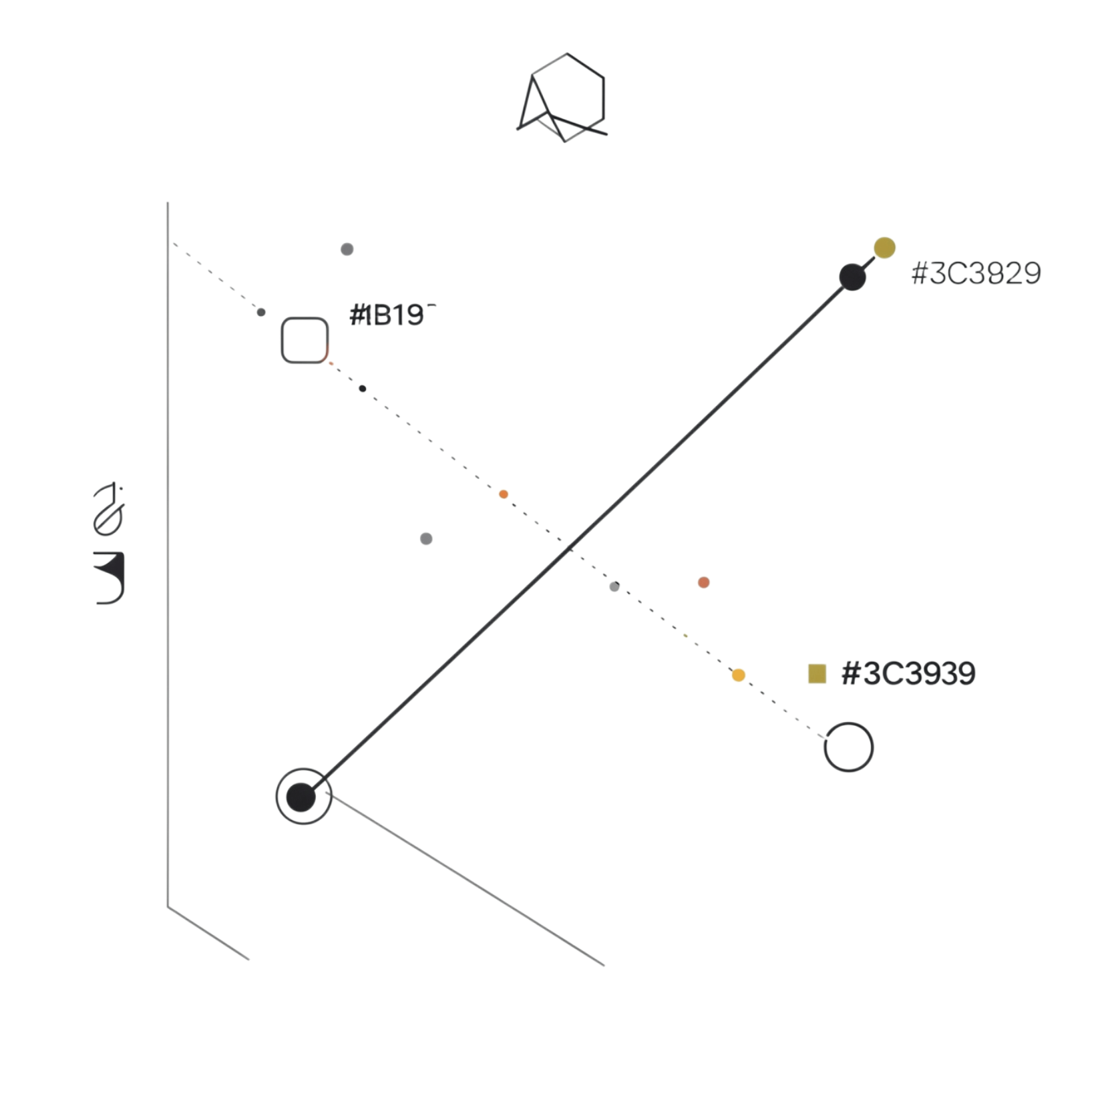
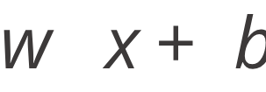
SVM Mathematical Example
Suppose the decision boundary is x₁ + x₂ − 5 = 0, where w = [1, 1] and b = −5.
Point P = (2, 4)
Result is positive → Prediction: Class +1
Point P = (1, 2)
Result is negative → Prediction: Class −1
The sign of determines which side of the boundary a point falls on — and therefore its predicted class.

Slide 6
Hard Margin vs Soft Margin
Hard Margin SVM
Soft Margin SVM
Requires perfect separation
No misclassification allowed
Works only when classes are clearly separable
Very sensitive to outliers
Allows some classification errors
More practical for real-world datasets
Controlled by the parameter C
Balances margin width vs. misclassification
The C Parameter — Intuition
Large C
Small C
Strong penalty for misclassification
Tries harder to classify training points correctly
Can lead to a smaller, tighter margin
Allows more violations
Encourages a wider margin
Can improve generalization on new data

Slide 7
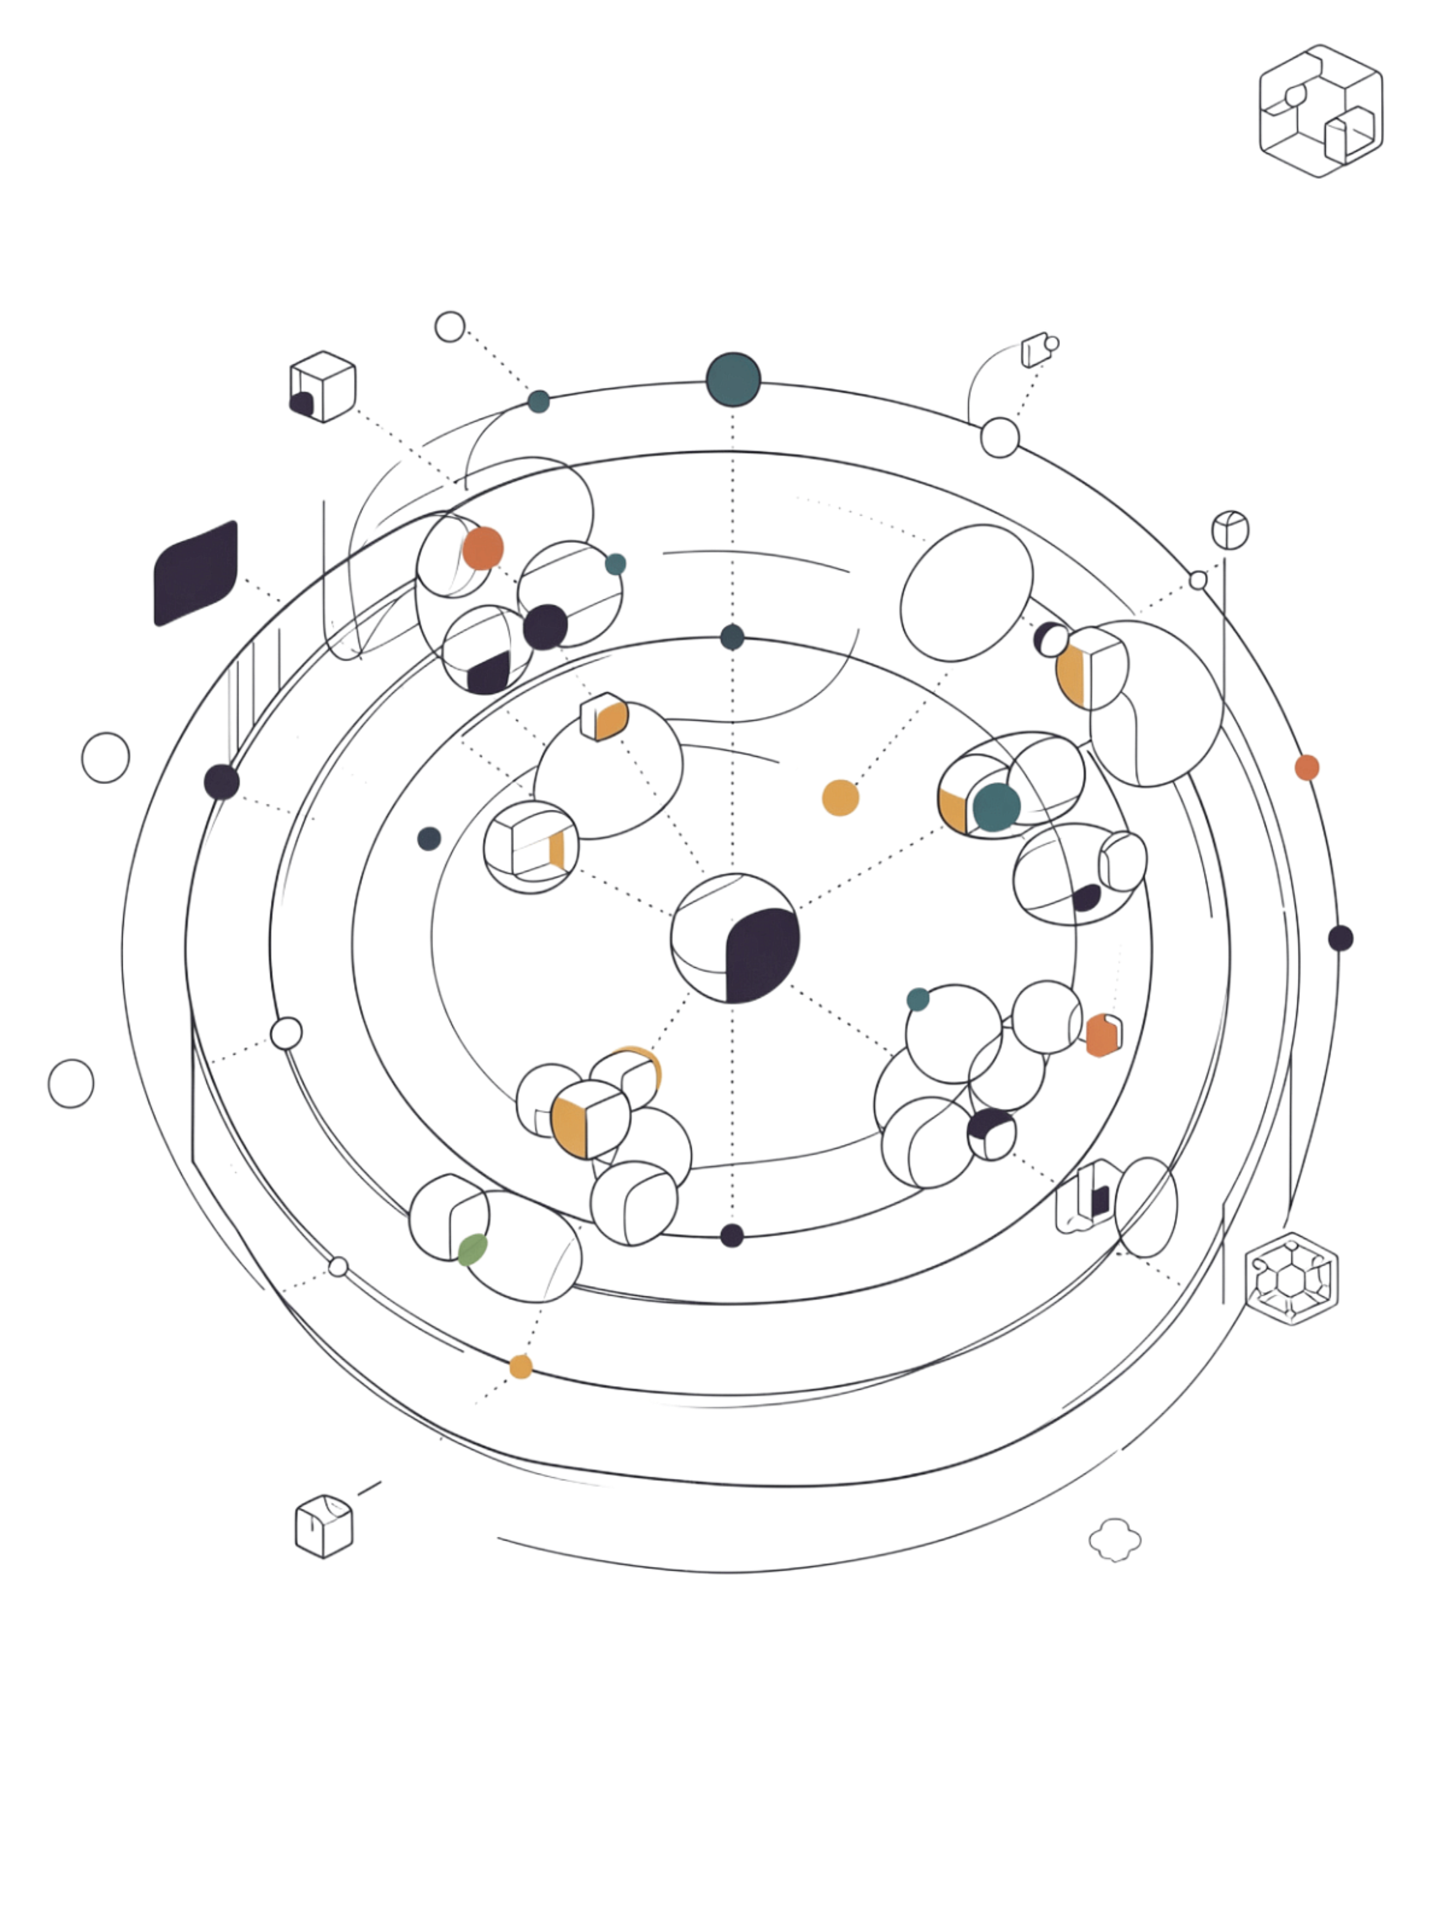
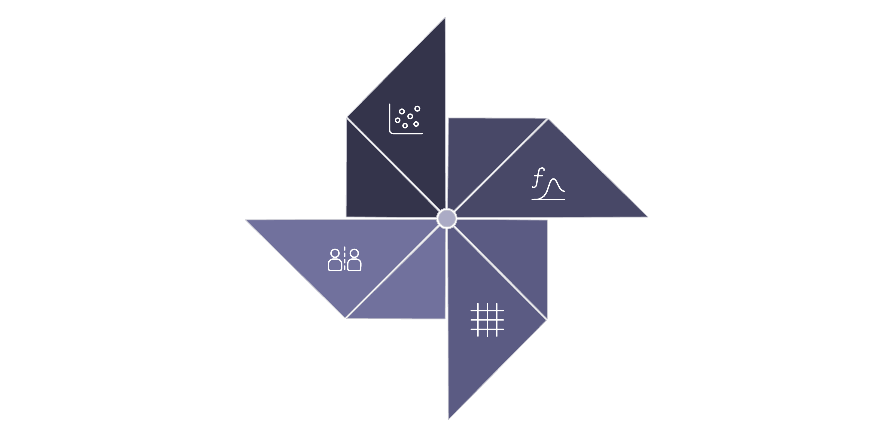
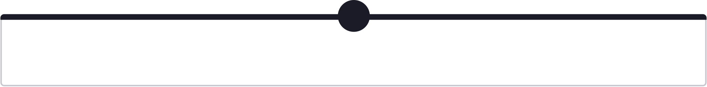


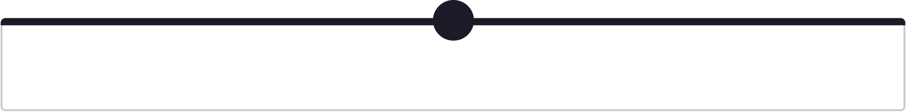


Kernel Trick
What happens when data cannot be separated by a straight line? A linear boundary fails on nonlinear datasets like concentric circles. The Kernel Trick solves this by mapping data into a higher-dimensional space where linear separation becomes possible.
Apply Kernel
Original 2D Data
Higher-Dimensional Space
Linear Separation
The kernel function computes similarity in the higher-dimensional space without explicitly computing the transformation — making it computationally efficient.
Linear
For linearly separable data
Polynomial
Captures polynomial relationships
RBF ⭐
Most commonly used nonlinear kernel
Sigmoid
Similar to neural network activation

Slide 8
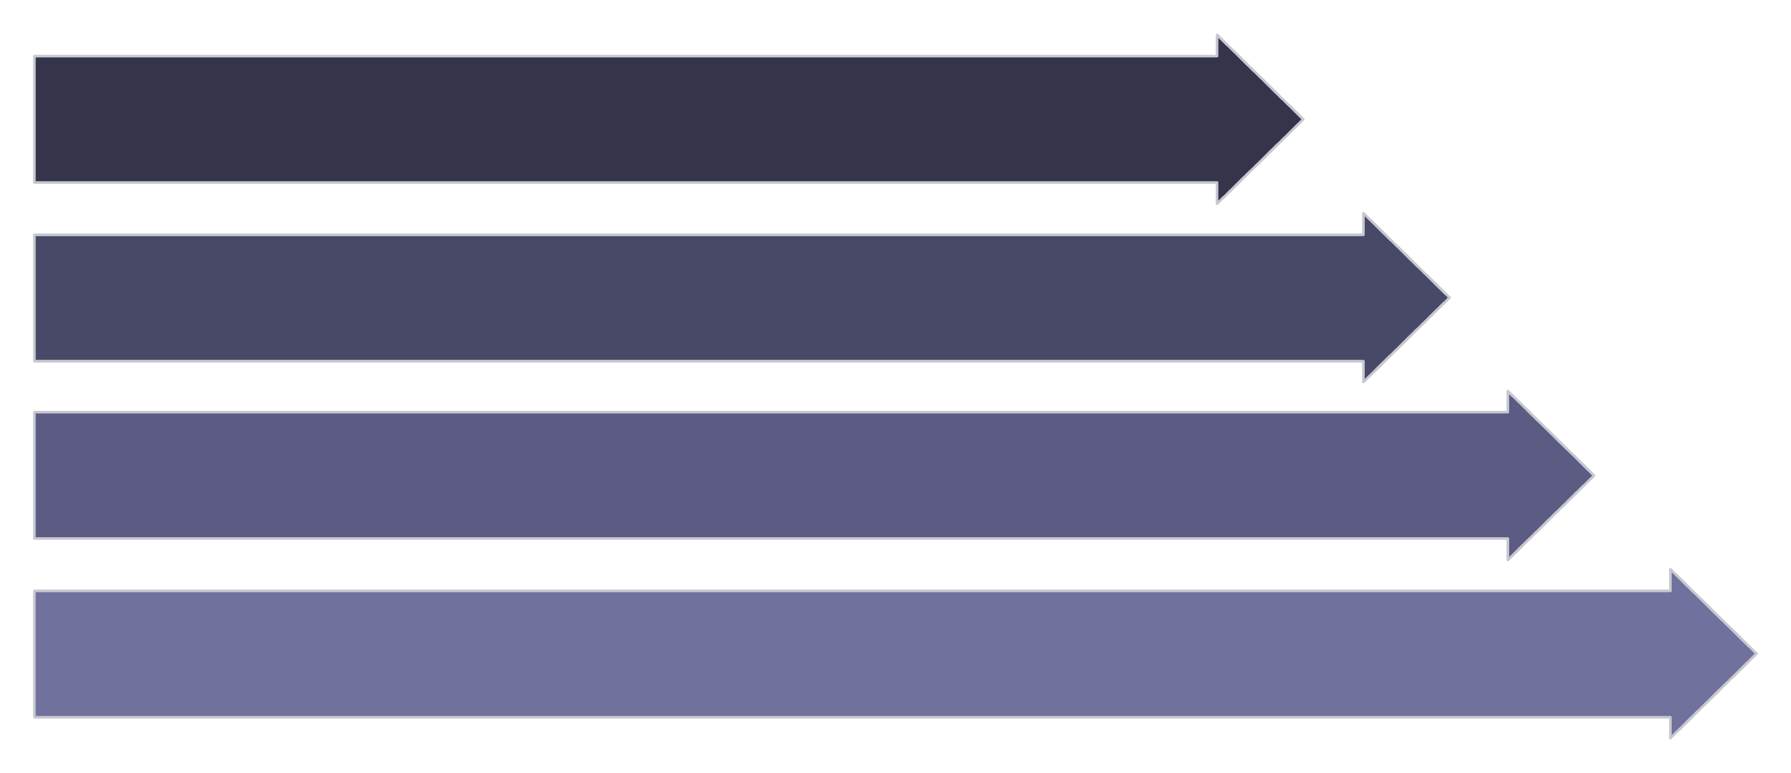

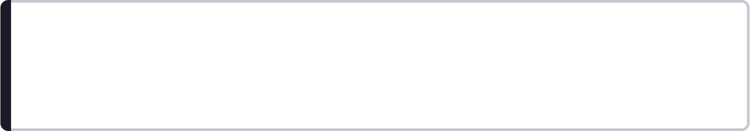
SVM Classification Workflow
Why Feature Scaling Matters
SVM relies on geometric distances. When features have very different scales, the optimization is dominated by the larger-scale feature.
Without scaling, Income dominates the distance calculation. After scaling (e.g., StandardScaler), both features contribute equally to the decision boundary — leading to a fairer, more accurate model.
Dataset
Feature Scaling
Choose Kernel
Train SVM
Always scale features before training an SVM.
Feature 1: Age
Feature 2: Income
Range: 20 – 60
Range: ₹20,000 – ₹2,00,000

Slide 9
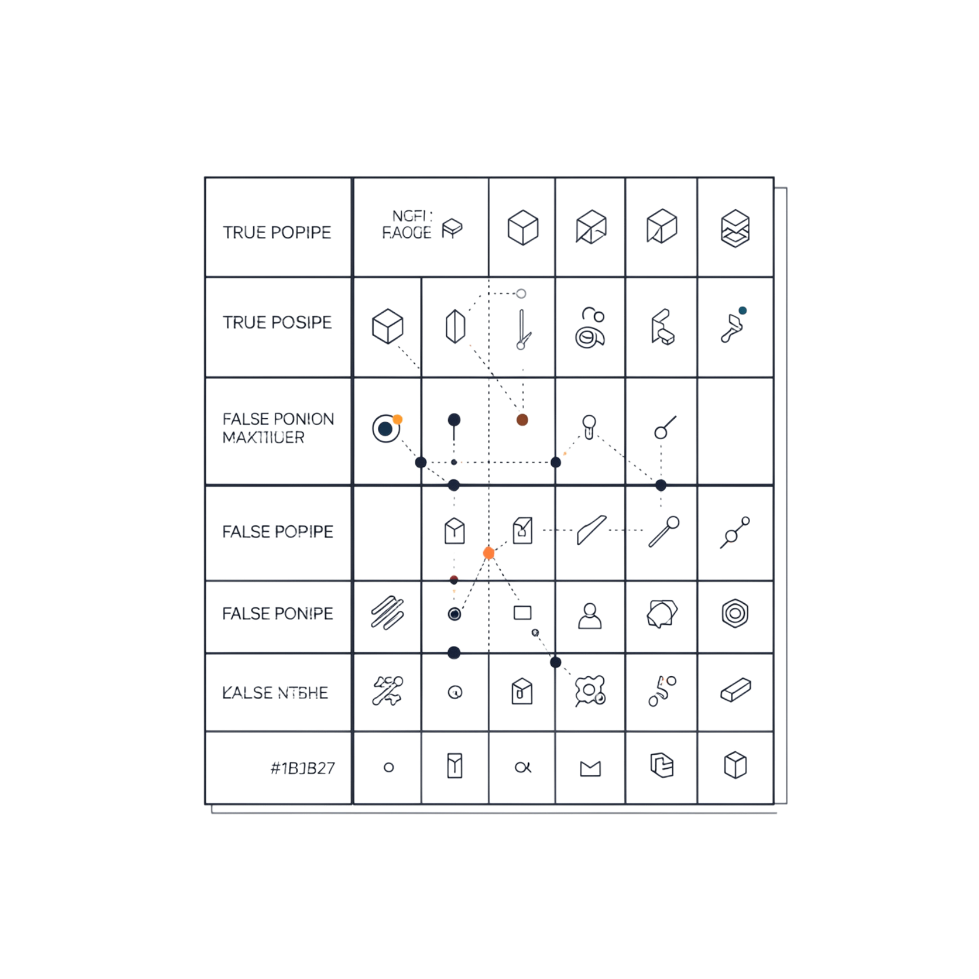
SVM Hyperparameters + Evaluation
Evaluation Metrics
Key Hyperparameters
C
Kernel
Controls the penalty for classification errors. Large C = strict; Small C = lenient.
Controls the type of decision boundary: Linear, Polynomial, RBF, Sigmoid.
Gamma (RBF)
High Gamma → More complex, local boundary (risk of overfitting)
Low Gamma → Smoother, broader boundary (better generalization)
Accuracy
Overall correct predictions
Precision
Correct positive predictions
Recall
True positives captured
F1 Score
Harmonic mean of Precision & Recall

Slide 10




Summary & Real-World Applications
Core SVM Concept
Real-World Applications
Find the decision boundary that maximizes the margin between classes.
Key Concepts
Image & Face Recognition
SVM Workflow
Classifying images and identifying faces in photos
Data → Scale Features → Choose Kernel → Train SVM → Maximum-Margin Boundary → Predict
Text & Spam Detection
Classifying emails, sentiment, and documents
Medical Classification
Diagnosing diseases from clinical data
Fraud Detection
Identifying fraudulent transactions in finance
SVC → CLASSIFICATION
SVR → REGRESSION
Decision Boundary
Margin & Support Vectors
Hard / Soft Margin + C
Kernel Trick + RBF + Gamma
Feature Scaling

